Slide 1
Biochar as a carbon amendment

Slide 2
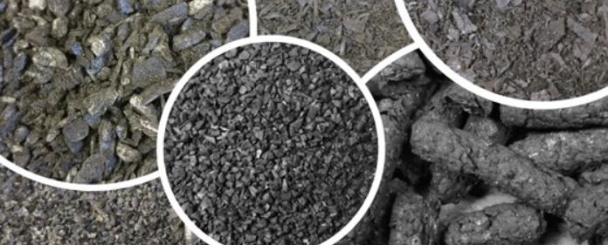
Overview
Biochar—what is it, anyway?
Why biochar?
Application
Photo: Kristin Trippe, USDA-ARS
Cochrane, NRCS

Slide 3
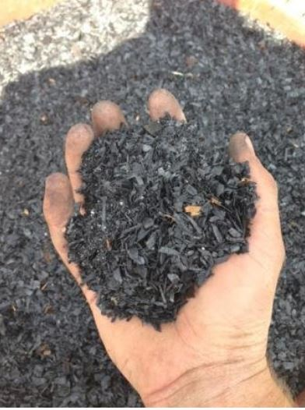
What is biochar?
A solid, carbon-rich material usually produced by Pyrolysis-- the thermochemical decomposition of organic material by heating at temperatures from 300 °C to over 750 °C, in the absence of oxygen.
Charcoal is biochar made from wood, the most common type of biochar. But biochar can also be made from many types of organic
materials—bagasse, straw, rice hulls, manure, etc., even biosolids and animal byproducts (offal, feathers, etc.).
Biochar is usually finely-divided. It has a low bulk density and contains an abundance of micropores.
Biochar is quite stable in soils and has a high cation exchange capacity (CEC).
Remsberg, SARE
The productivity of conventional agricultural systems are maintaine with increased inputs: technology, labor, fuel, nutrients, pesticides, water, tillage, etc…

Slide 4
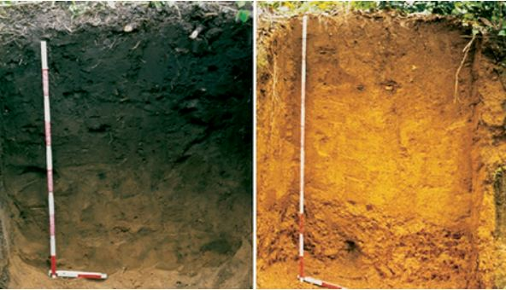
Why biochar?
-A “proven performer as a soil amendment for agricultural soils.
-”Terra Preta” soils in Amazonia—deep, dark, fertile soils in the midst of a region characterized by Oxisols.
-Have been productive for hundreds or thousands of years.
-Investigation showed high content of biochar—apparently incorporated intentionally by the indigenous people who lived there.
Image from Utah State University, courtesy of Glaser, Bruno, Ludwig Haumaier, Georg Guggenberger and Wolfgang Zech, Semantic Scholar.
Remsberg, SARE
The productivity of conventional agricultural systems are maintaine with increased inputs: technology, labor, fuel, nutrients, pesticides, water, tillage, etc…

Slide 5
Characteristics important for agriculture
-
Biochar is not ash, but it often carries ash with it as a co-product—typically has a high pH.
Biochar has a high CEC, but it won’t be accessible unless it’s finely ground—particle size vs. surface area.
CEC, stability, inherent fertility, etc. vary according to feedstock and production temperature.
Half life of biochar in soils can vary from decades to millenia.
Most biochar is a “blank slate” with respect to nutrient content—to be effective as a soil amendment, it usually needs to be “charged.”
Biochar can be an effective amendment to improve the fertility and water holding capacity of soils.
Remsberg, SARE
The productivity of conventional agricultural systems are maintaine with increased inputs: technology, labor, fuel, nutrients, pesticides, water, tillage, etc…

Slide 6
Important characteristics for agriculture
-
The interest in using biochar as a soil amendment is increasing.
Biochar is available commercially in many areas of the country, including South Carolina
Soils most likely to benefit from biochar application:
  Soils with low inherent fertility (CEC), low water holding capacity, low organic matter levels, and shallow slopes: Soils like most of those in the Coastal Plain and Piedmont regions.
  High value crops cultivated on small footprints (greenhouse, high tunnel, small acreage produce/ fruit, etc.).
  Reclamation sites.
Considerations for farmers:
  Cost
  Availability
  Equipment available
Remsberg, SARE
The productivity of conventional agricultural systems are maintaine with increased inputs: technology, labor, fuel, nutrients, pesticides, water, tillage, etc…

Slide 7
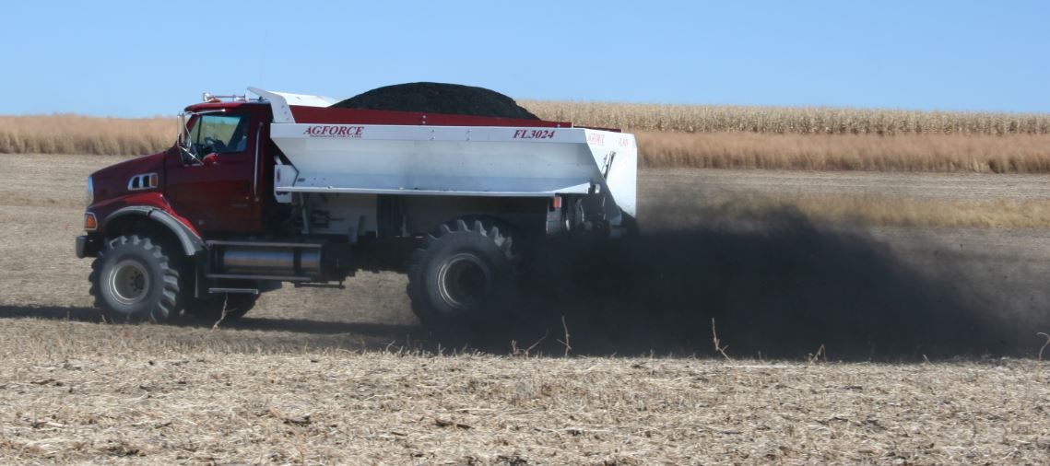
Applying biochar
-Typical application rates: 1 – 10 t/a (approximately 4 – 40 yd³/ acre)
-Fertilizer spreaders more practical than manure spreaders, but mixtures of manure or compost and biochar may need specialized equipment.
-Biochar needs to get into the soil in order to be effective: Tillage, bioturbation?
Image: Iowa State University
Remsberg, SARE
The productivity of conventional agricultural systems are maintaine with increased inputs: technology, labor, fuel, nutrients, pesticides, water, tillage, etc…

Slide 8
Summary
Biochar characteristics vary widely according to feedstock and pyrolysis method
Biochar can be an effective amendment to improve fertility, water holding capacity, and organic matter content of soils.
Biochar is generally not a stand-alone soil amendment—needs a source of nutrients to supply fertility.
Many southeastern soils could benefit from biochar, but site and other factors need to be considered.
Photo: Kristin Trippe, USDA-ARS
Cochrane, NRCS

Slide 9
Handy biochar links
https://www.nrcs.usda.gov/resources/guides-and-instructions/soil-carbon-amendment-ac-336-conservation-practice-standard
http://www.pnwbiochar.org/tools/tools_336/
https://pacificbiochar.com/biochar-application-calculator/
https://www.nrcs.usda.gov/resources/data-and-reports/web-soil-survey

Slide 10
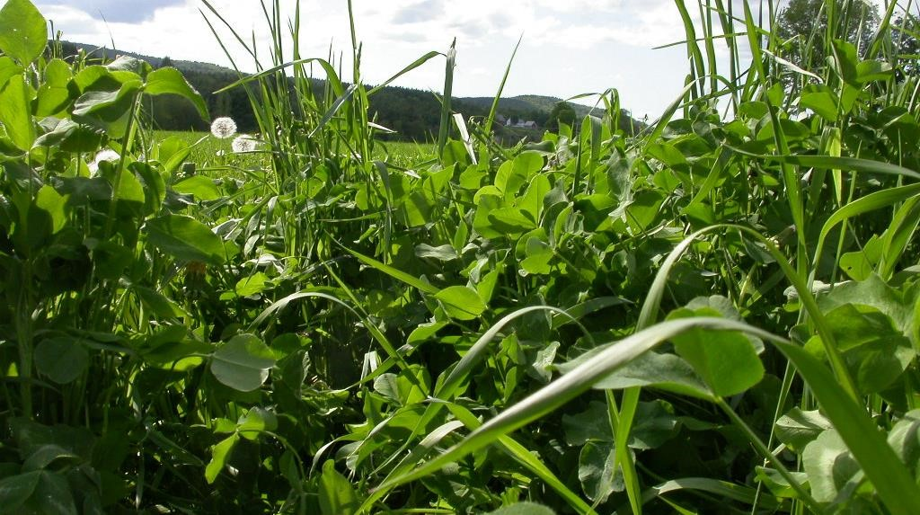
Disclaimer
This information is provided as a public service and constitutes no endorsement by the United States Department of Agriculture or the Natural Resources Conservation Service of any service, supply, or equipment listed.
While an effort has been made to provide a complete and accurate listing of services, supplies, and equipment, omissions or other errors may occur and, therefore, other available sources of information should be consulted
The USDA is an equal opportunity provider and employer.
Meeh, NRCS

